Slide 1

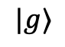
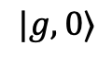
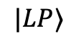
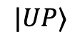
$$|UP⟩$$
$$|e⟩$$
$$|LP⟩$$
$$|g⟩$$
$$|g,0⟩$$

Slide 2
$$|UP⟩$$
$$|e⟩$$
$$|LP⟩$$
$$|g⟩$$
$$|g,0⟩$$

Slide 3
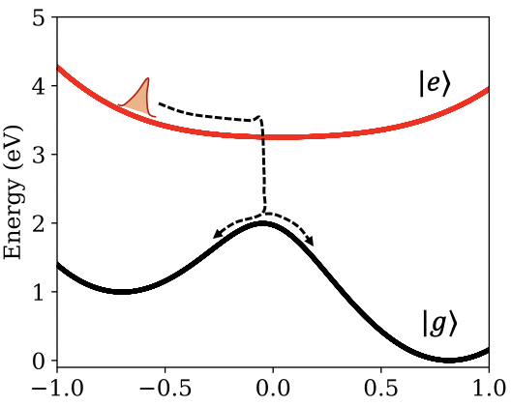
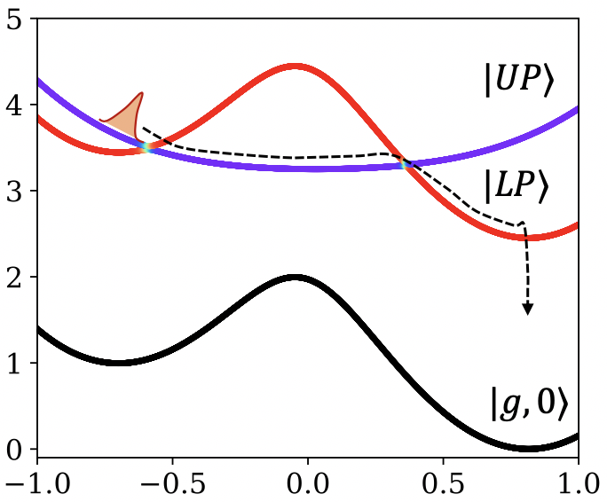
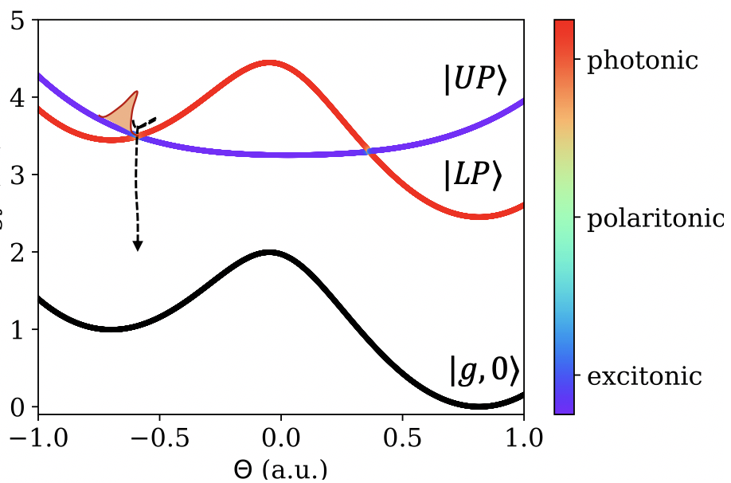
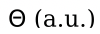
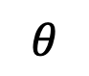
No Coupling
Strong Coupling, Low-Loss
Strong Coupling, High-Loss
$$θ$$

Slide 4


(a) Strong Coupling, Low-Loss
(b) Strong Coupling, High-Loss
Energy (eV)
$$R$$
$$R$$
R (a.u.)
R (a.u.)

Slide 5
(a)
(b)
(c)
(d)

